Slide 1
Presentation of the association AITAP
Accueil et Informations des Thésards pour leur Avenir et leur Présent
Presented by Oliveira Alexandre, President of the association

Slide 2
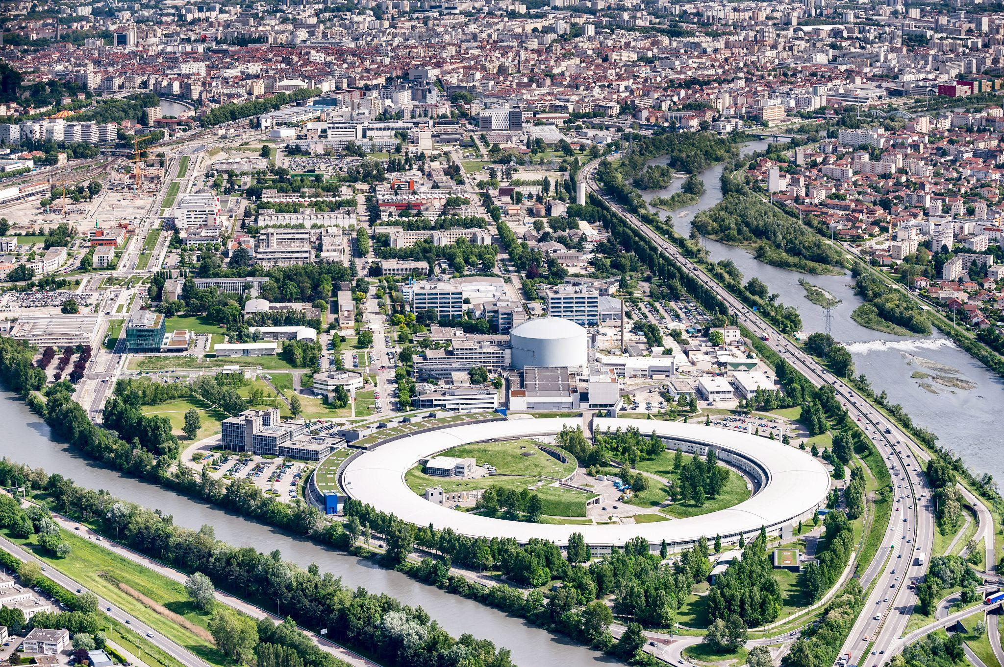
CEA Grenoble
Employees | In numbers
Interns : | 245
Work-study students : | 237
PhDs & Post-docs : | 775
CDDs : | 463
Total : | 1720
Presentation of the association AITAP

Slide 3
Association of Young Researchers at CEA Grenoble
Presentation of the association AITAP

Slide 4
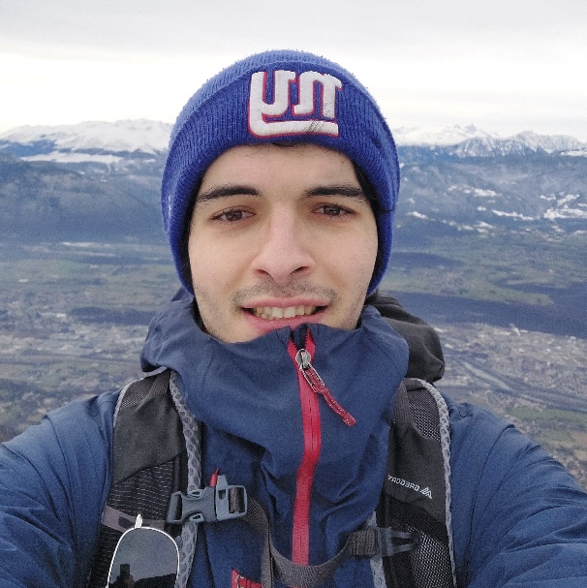
President of AITAP
PhD student in 3rd year LETI
I took the association in january
I am the e-mail guy
“When I took over the association in January, I wanted to create a space that would improve the lives of young researchers in a professional and scientific sense, but also in a social and relational sense. This space would be a place where they could discover themselves and explore new projects.”
Alexandre Oliveira
Presentation of the association AITAP

Slide 5
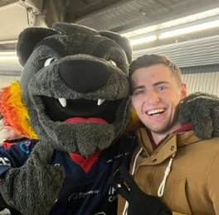
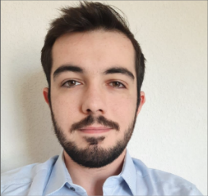
Members
Alexandre Oliveira
3rd year PhD student
President of AITAP
Sam Fiette
1st year PhD student
Secretary of AITAP
Laura Bettou-Claus
Part-time student in comm. and public relations
Head of comm. of AITAP
Head of digital comm. at
Roberto Barbano
1st year PhD student
Sports Delegate of AITAP
Timothée Labau
1st year PhD student
Treasurer of AITAP
Associative experiences : President & Secretary
MI : Popularization of sciences
Presentation of the association AITAP

Slide 6
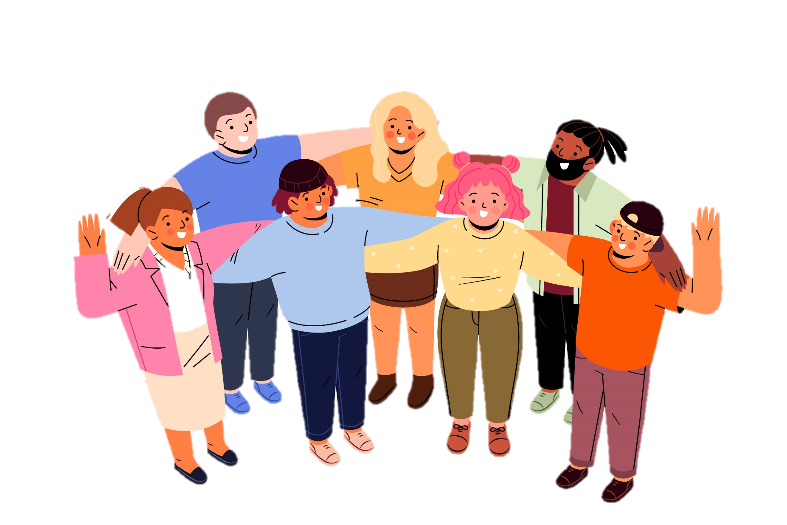
Objective of AITAP
Promoting research environment for young researchers at
CEA Grenoble
Create and Relay events on :
Socialization
Support & Well-being
Professional & Scientific
Presentation of the association AITAP
Notes:
On relai des projets existants dans ses trois thématiques et on créé de nouveaux projets

Slide 7
Socialization
Events :
Afterworks (1 each month : day of the newcomers presentation)
Integration day (weekend)
cultural and sporting activities (MC2, sports centres)
Who :
Young researchers of CEA Grenoble
Young researchers of CEA (INES, Marcoule, Saclay)
Young researchers of Grenoble (AGreD)
Presentation of the association AITAP

Slide 8
Support & Well-being
Offering space and support :
Discussion forums
Workshops (sport, cooking, …)
Programme CARE (Mélanie Grange-daval, doctor at CEA)
Handicap and gender-based violence (Emma)
Presentation of the association AITAP

Slide 9
Professional & Scientific
Provide knowledge :
Seminars
Workshops (Midi Minatec)
Summer and winter schools
scientific literature courses (IST)
Promote young researchers :
Networking events (JSIAM GIANT)
Laboratory visits (Welcome of CEA Marcoule : 30/05)
Connections between universities and industrials
Presentation of the association AITAP
Notes:
On se posittionne en tant que relai et on veu proposer nos propres évènements

Slide 10
Diversity and disability mission at CEA Grenoble
Presented by Emma Boulivet Lucchini, emma.boulivetlucchini@cea.fr

Slide 11
CEA actions for people with disabilities
Disability agreement: 6% objective
Equal rights and opportunities, respecting differences
No discrimination in the workplace on the grounds of disability
People with disabilities are recruited on the basis of their professional skills
Adaptation of workstations to compensate disability
Disability budget CEA Grenoble
Diversity and disability mission at CEA Grenoble

Slide 12
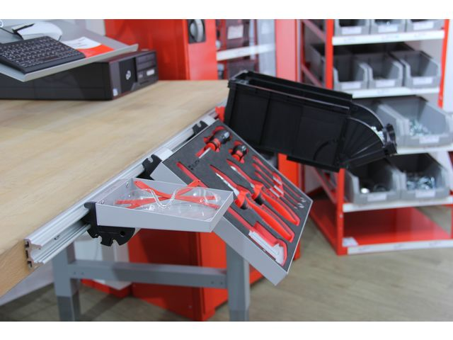
CEA actions for people with disabilities²
Condition: apply officially for disabled worker status (RQTH: Reconnaissance de la Qualité de Travailleur Handicapé, Carte mobilité Inclusion, disability pension, etc.), a process initiated by the employee.
How: with the help of the SPST and social workers, apply to the MDPH.
Examples of the types of difficulty that can give rise to TH status, and their adjustments :
Dyslexia:
After-effects of an accident:
Hearing or visual impairment:
Attention deficit disorder (ADHD):
Fatigability resulting from a disabling illness:
Effects of depression:
correction or voice recognition software...
ergonomic equipment (ergo chairs, etc.)
co-financing of hearing aids, electronic magnifiers, etc.
managerial support, adapted training
flexible working hours, medical telecommuting
managerial support, personalized follow-up
Diversity and disability mission at CEA Grenoble
Notes:
Pour les personnes devant faire face à un problème de santé nécessitant des conditions de travail particulières pour exercer leur emploi, des aménagements de postes sont possibles si la situation de handicap a été reconnue officiellement, par exemple, par le biais du dépôt d’une demande de RQTH, (reconnaissance de la qualité de travailleur handicapé), d’une pension d’invalidité ou rente AT/MP incapacité permanente, ou encore de la carte mobilité inclusion…
Le budget annuel réservé aux aménagement de postes s’élève à prés de 500 000€ /an et les actions sont conçues sur mesure pour chaque personne :
Matériel ergonomique sur site et/ou pour le télétravail.
Accompagnement individuel,
Aides auditives, compensation de la déficience visuelle,
Aménagement du temps de travail,
Mesure de télétravail médical,
Formation spécifique,
Suivi personnalisé…

Slide 13
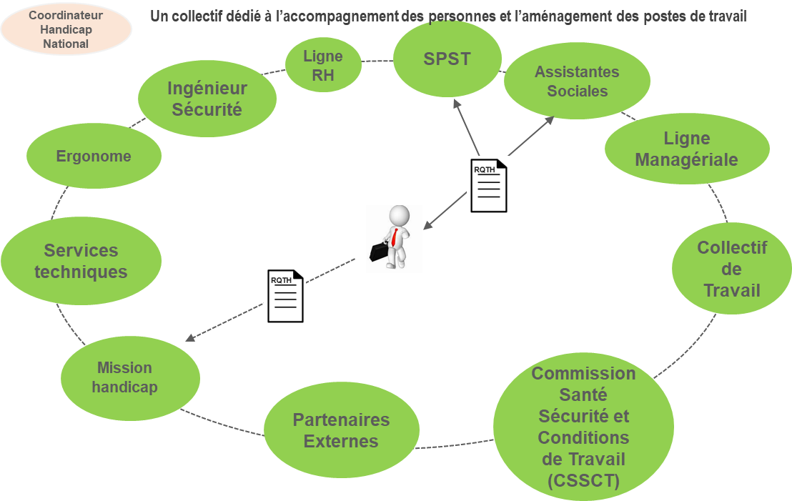
A MULTI-DISCIPLINARY ORGANIZATION TO DESIGN CUSTOM WORKSTATION FITTINGS
Contact : missionhandicapgrenoble@cea.fr
Diversity and disability mission at CEA Grenoble

Slide 14
Prevention of sexism
Poster campaign against sexism + sexual harassment.
Mandatory training on sexism.
Workshops organized regularly throughout the year to raise awareness and react to sexism.
Intranet informations
emma.boulivetlucchini@cea.fr
Diversity and disability mission at CEA Grenoble

Slide 15
Thank you !
Courses on : https://www.instart-learning.eu/Home

Slide 16
AITAP
Volunteers
Socialization
Board
Professional & Scientific
Support & Well-Being
Volunteers
Volunteers
Presentation of the association AITAP

Slide 17
Board
President :
Assumes the association’s responsability
Ensures the operation of the association
President
Head of comm. :
Manages communication tools
Secretary :
Sends out invitations
Makes the reports
Corresponds with public authorities
Secretary
Head of comm.
?
Treasurer :
Keeps the account books
Makes forecasts
Approves financial projects
?
Treasurer
Vice-President
Other
Presentation of the association AITAP

Slide 18
Support & Well-being : sports
Objective :
Inclusion
Stress management
Connections between people
Know new places
?
Delegate
?
How :
Sport clubs (on social platforms)
Connection with other associations
Direct organization with the members of AITAP
?
?
Presentation of the association AITAP

Slide 19
Volunteers
Present voluntarily at events
Do specific tasks in events
Recognizable with their T-Shirts !
Presentation of the association AITAP

Slide 20
Why being part of AITAP ?
free subscription !
For members of AITAP | For adhérents
Being in a project | Making new contacts
Developping new skills | Enhancing your research life
Helping others | Taking care of yourselves
Driving initiatives Free or Pay less to attend events
Presentation of the association AITAP

Slide 21
Contacts
CEA | Doctoral college of Grenoble | Professional
Presentation of the association AITAP

Slide 22
Forecast
September
State of Progress
New meeting
August
July
June
4 months to form the association
Easy-to-organise events
it's up to you !
May
Presentation of the association AITAP

Slide 23
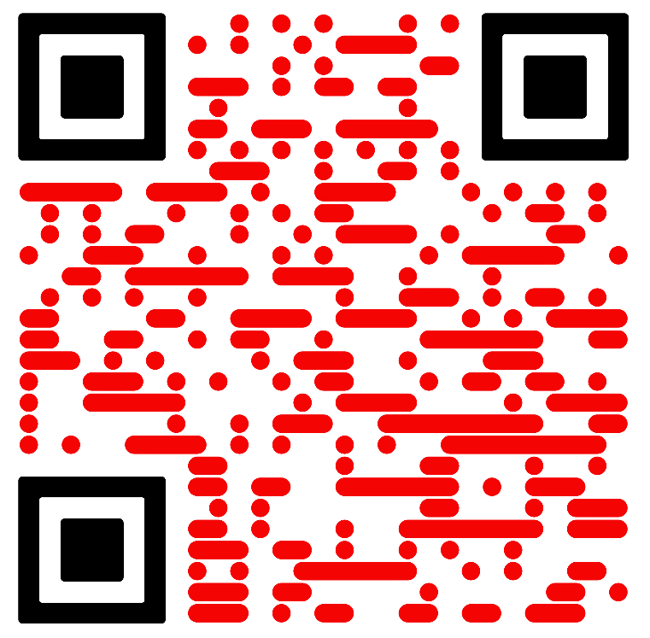
Thank you for attending !
Interested ?
QR or https://www.aitap.com/
CEA GRENOBLE - AITAP
aitap@cea.fr
Oliveira Alexandre +33 4 38 78 96 81

Slide 24
Annex : Committees
Delegate
Being part of a dynamic environment
Initiative-takers about next events
Work in a specific action of a topic
1 committee per action
Scribe
Presentation of the association AITAP

Slide 25
Forecast
 | 2024 |  |  |  |  |  |  |  | 2025
A | M | J | J | A | S | O | N | D | J
Next steps
Organisation of the board | Administrative and legal
 | Assignement of positions
 | Details of the actions
 | Creation of communication tools
 | Partenerships
 | progress report and future of the association
Social events | Relay
 | Creation
Support & well-being events | Relay
 | Creation
Professional & Scientific events | Relay
 | Creation
Presentation of the association AITAP

